Slide 1
I will show you
What can this robot do

Slide 2
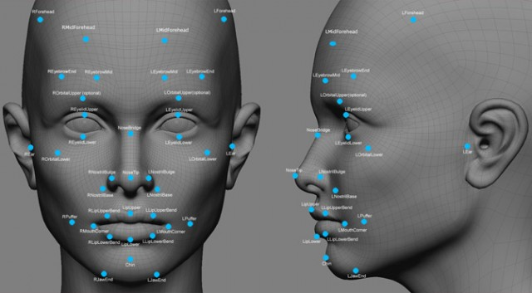
Face recognition

Slide 3
What can we detective
Your face location
Glassed
Happy/smile
Left or right eye closed
Mouth open
Maxim supported for two face

Slide 4
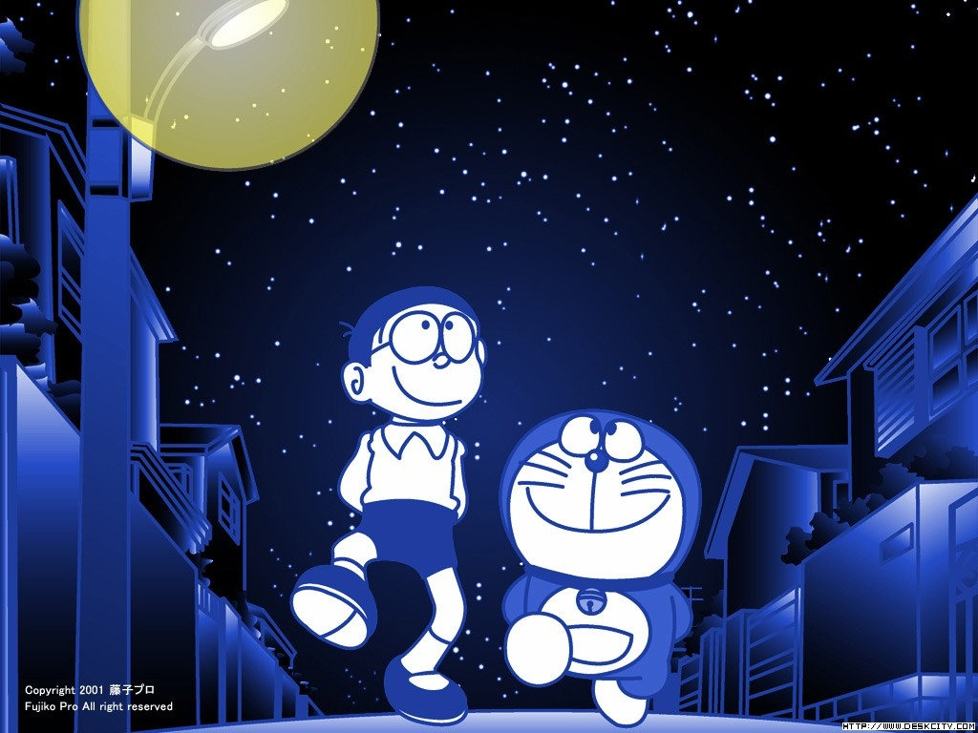
Tracking people

Slide 5
Tracking people
Track the people
Reach the speed of 1m/s
A friend will not leave your too far

Slide 6
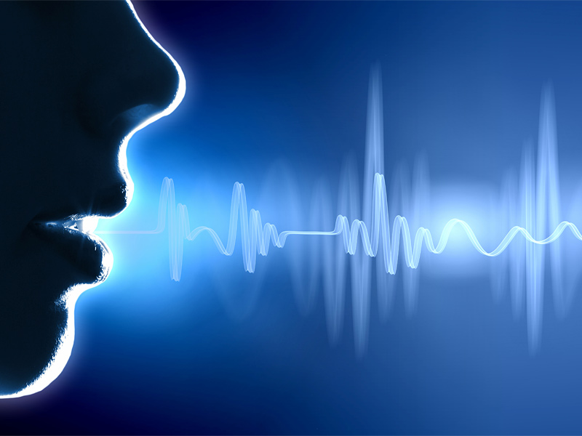
Voice control

Slide 7
Just open your month
Control movements of this robot
This robot just listen to you
It’s offline you can use it everywhere

Slide 8
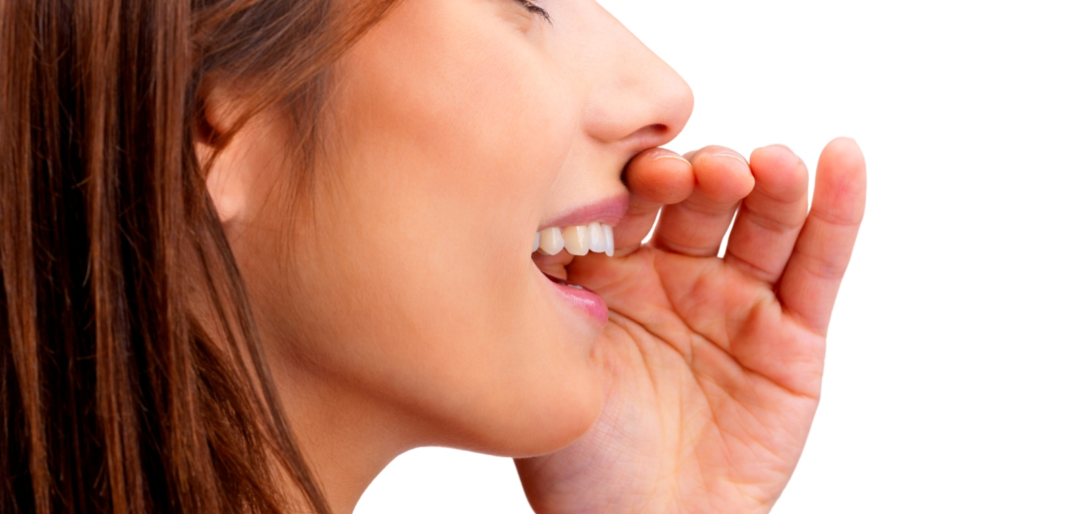
Voice recognition

Slide 9
Understand your words
Recognize best language in world
Based on technology of BAIDU
Understand Chinese culture and other things
Support by baidu

Slide 10
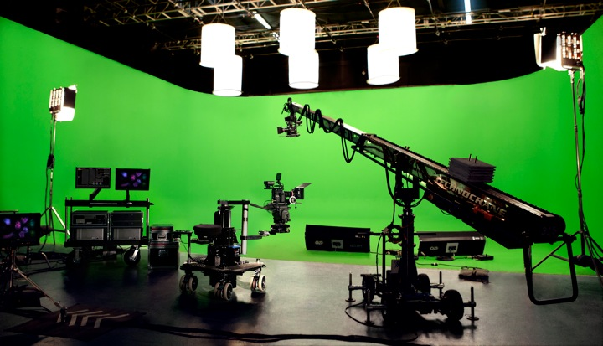
Green screen

Slide 11
Green screen
Remove all the background
All location all time
Just like it’s produced by adobe after affects

Slide 12
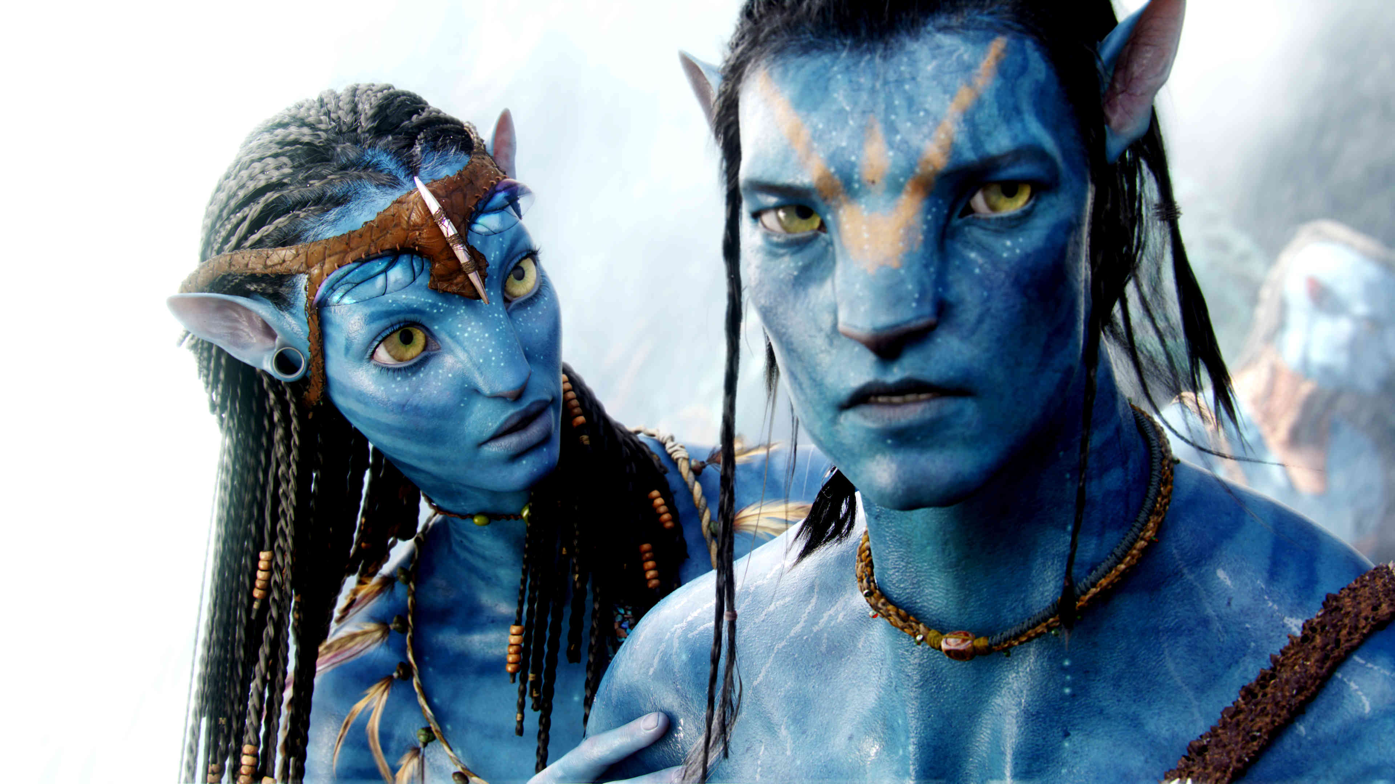
Avatar

Slide 13
avatar
A musk based on your face
Accurate synchronous of every emotion of your face
you can even have a unique 3d model of your face

Slide 14


Slide 15
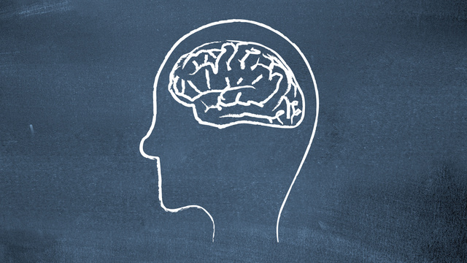
We could create more

